Slide 1
Computing with Physical Systems Part 1: Computer Engineering
Peter McMahon
Aspen Center for Physics
8 January 2024
https://mcmahon.aep.cornell.edu/aspen/2024/

Slide 2

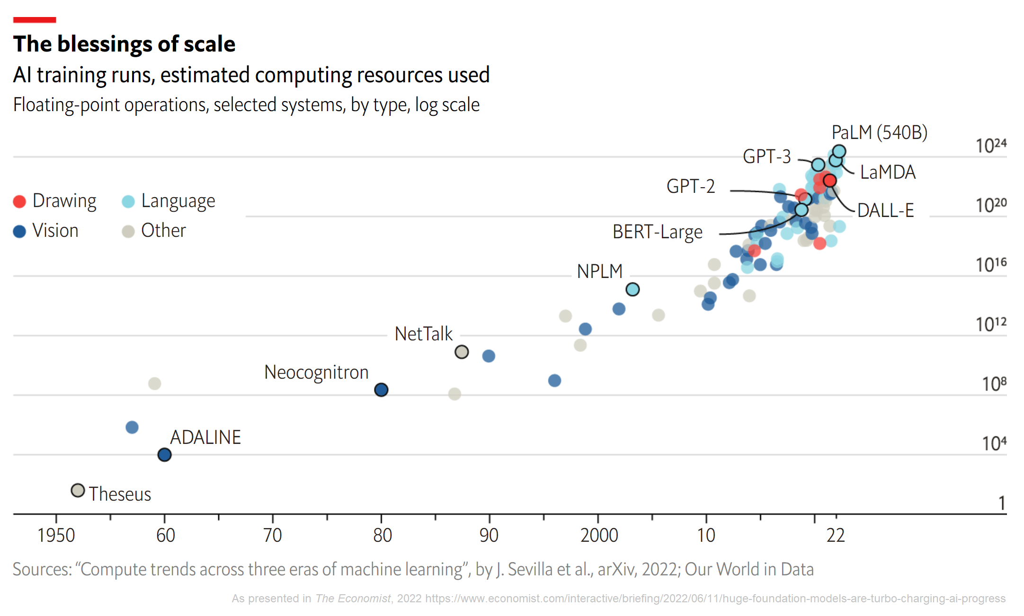
Why do we need more speed & energy efficiency?

Slide 3
Why do we need more speed & energy efficiency?
Source: Google Research (2022)

Slide 4
Why do we need more speed & energy efficiency?

Slide 5
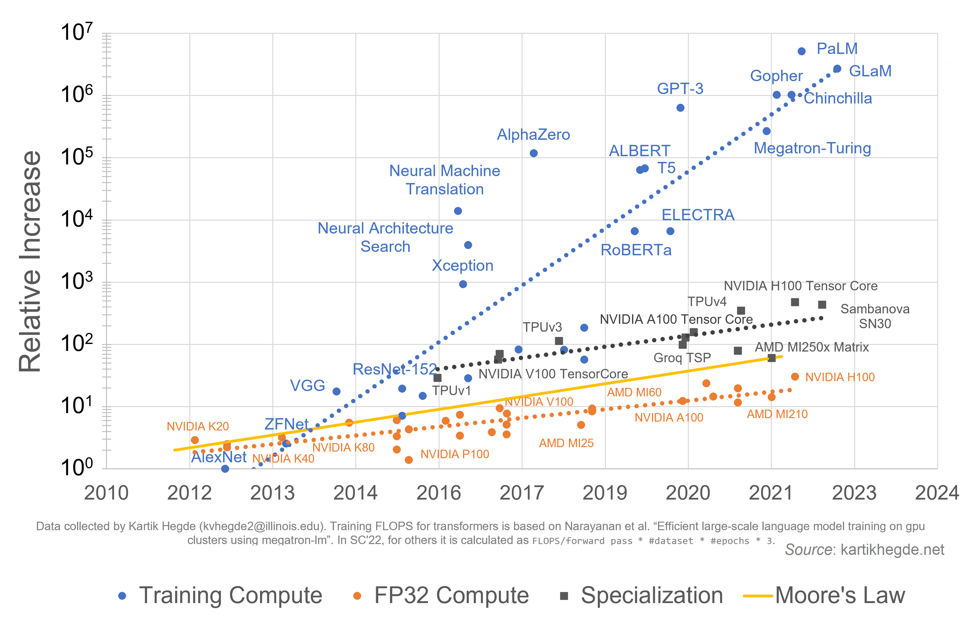
Why do we need more speed & energy efficiency?
Deficit
Specialization Boost

Slide 6
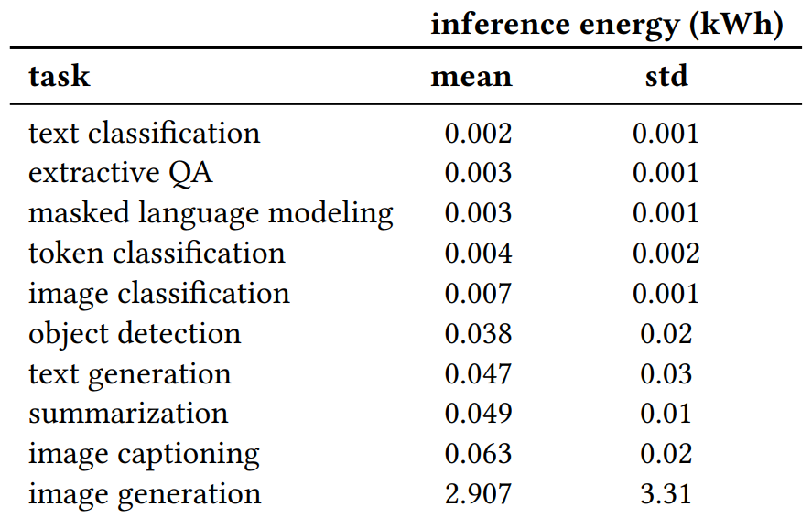
Why do we need more speed & energy efficiency?
Machine-learning inference (e.g., making predictions; generating text or images, etc.) already uses a lot of energy:
~ the energy used by a household
refrigerator running for several hours
Source: A. Luccioni et al. arXiv:2311.16863 (2023)

Slide 7
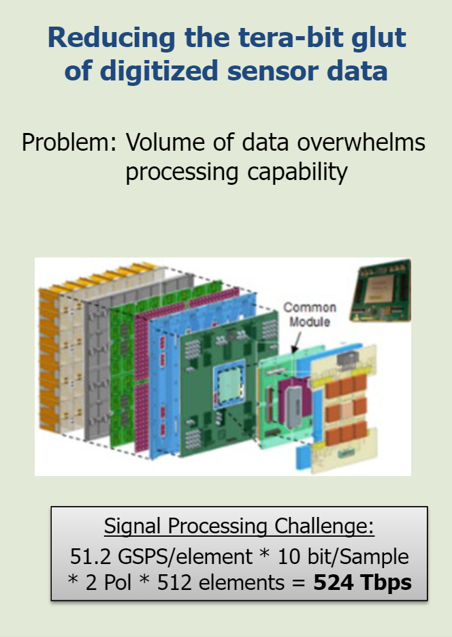
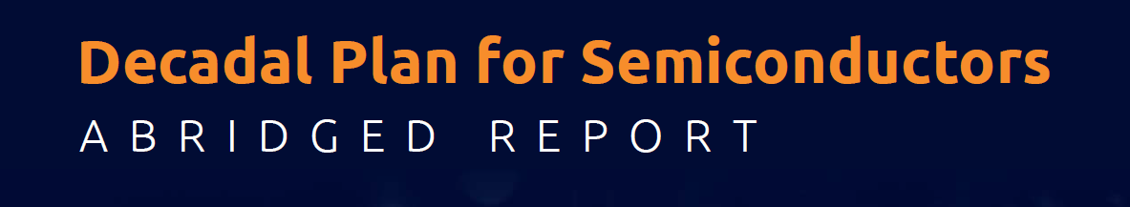
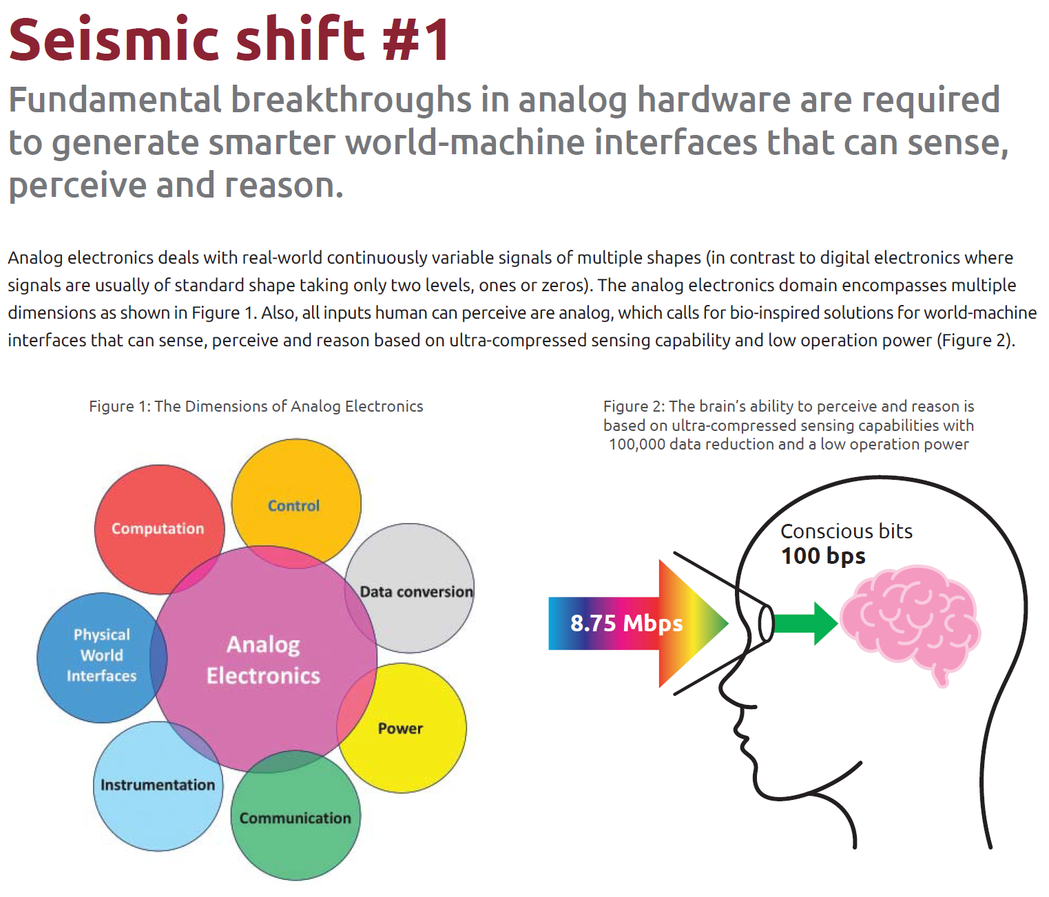
Sensing the physical world also has demanding computing needs that are growing rapidly and require orders-of-magnitude improvements in computer performance
Source: Young-Kai Chen (DARPA, 2021)
Source: Semiconductor Research Corp. (2020)

Slide 8
How can we get large performance improvements?

Slide 9
How can we get large performance improvements?
Abstractions Elimination
Instead of insisting on digital, deterministic signals and logic, use analog and/or probabilistic computation.
Design behavior from the bottom up (using the available physics) instead of top-down (forcing the physics to conform to some abstraction).

Slide 10
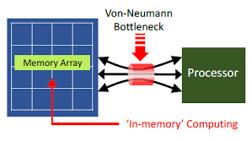
How can we get large performance improvements?
Abstractions Elimination
Instead of insisting on digital, deterministic signals and logic, use analog and/or probabilistic computation.
Design behavior from the bottom up (using the available physics) instead of top-down (forcing the physics to conform to some abstraction).
In-memory Computing
Eliminate the von Neumann bottleneck.
Source: SRC JUMP C-BRIC (2019)

Slide 11
How can we get large performance improvements?
Abstractions Elimination
Instead of insisting on digital, deterministic signals and logic, use analog and/or probabilistic computation.
Design behavior from the bottom up (using the available physics) instead of top-down (forcing the physics to conform to some abstraction).
In-memory Computing
Eliminate the von Neumann bottleneck.
Alternative Hardware/Modalities
Explore alternative hardware devices/platforms that could be more effective for special-purpose computation (photonics, spintronics, novel nanomaterials, CMOS+X, etc.).
For very specific applications: quantum computing.
Source: SRC JUMP C-BRIC (2019)

Slide 12
How can we get large performance improvements?
Abstractions Elimination
Instead of insisting on digital, deterministic signals and logic, use analog and/or probabilistic computation.
Design behavior from the bottom up (using the available physics) instead of top-down (forcing the physics to conform to some abstraction).
In-memory Computing
Eliminate the von Neumann bottleneck.
Alternative Hardware/Modalities
Explore alternative hardware devices/platforms that could be more effective for special-purpose computation (photonics, spintronics, novel nanomaterials, CMOS+X, etc.).
For very specific applications: quantum computing.
Variations Tolerance
Don’t insist that every copy of the hardware behave the same way.
Tolerate some amount of re-training/re-configuring (Hinton: “mortal computing”), or design algorithms for resilience to hardware variations.
Source: SRC JUMP C-BRIC (2019)

Slide 13
How can we get large performance improvements?
Abstractions Elimination
Instead of insisting on digital, deterministic signals and logic, use analog and/or probabilistic computation.
Design behavior from the bottom up (using the available physics) instead of top-down (forcing the physics to conform to some abstraction).
In-memory Computing
Eliminate the von Neumann bottleneck.
Alternative Hardware/Modalities
Explore alternative hardware devices/platforms that could be more effective for special-purpose computation (photonics, spintronics, novel nanomaterials, CMOS+X, etc.).
For very specific applications: quantum computing.
Variations Tolerance
Don’t insist that every copy of the hardware behave the same way.
Tolerate some amount of re-training/re-configuring (Hinton: “mortal computing”), or design algorithms for resilience to hardware variations.
Source: SRC JUMP C-BRIC (2019)
To achieve improvements of many orders of magnitude most likely requires a combination of many improvements (the ~100,000x increase for CPUs between 1985 to 2015 resulted from many advances in devices, circuits, architecture and compilers).
This approach is only relevant to making special-purpose processors each targeting a restricted set of application domains, e.g., machine learning, optimization, and possibly scientific computing. We are not proposing to replace all general-purpose computing.
Source: Leiserson et al. Science 368, 1079 (2020)

Slide 14
Physics-based computing gains energy efficiency & speed by eliminating layers of abstraction
Current Digital Computing
(including CPUs, GPUs, TPUs)
User Applications
Algorithms
Top-down philosophy: design a hierarchy of abstractions, starting from the premise of running stored programs digitally and deterministically
Function Libraries
Compilers
Operating Systems
Processors
Functional Cores
Arithmetic Logic Units / Processing Elements
Adders, Multipliers, etc.
Logic Gates
Digital Signals
CMOS Transistors
CPU: Central Processing Unit; GPU: Graphics Processing Unit; TPU: Tensor Processing Unit

Slide 15
Physics-based computing gains energy efficiency & speed by eliminating layers of abstraction
Current Digital Computing
(including CPUs, GPUs, TPUs)
User Applications
Physics-based Computing
Bottom-up philosophy: find physical processes and hardware that natively perform complex but controllable computations, then harness them for useful applications
Algorithms
Top-down philosophy: design a hierarchy of abstractions, starting from the premise of running stored programs digitally and deterministically
Hardware Connectivity & Parameters (Circuit Design)
Function Libraries
Compilers
Operating Systems
CMOS Transistors / Unconventional Hardware
Processors
Functional Cores
Arithmetic Logic Units / Processing Elements
Adders, Multipliers, etc.
Hardware Connectivity and Parameters induce certain Dynamics, which in turn induces an Algorithm.
Programming ↔ Adjusting tunable parameters or connectivity of the hardware.
No separation between the “program” and the processing hardware running the algorithm.
Logic Gates
Digital Signals
CMOS Transistors
CPU: Central Processing Unit; GPU: Graphics Processing Unit; TPU: Tensor Processing Unit

Slide 16
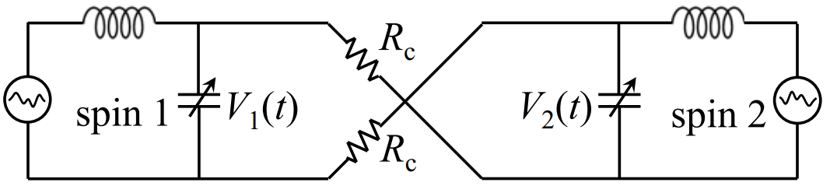
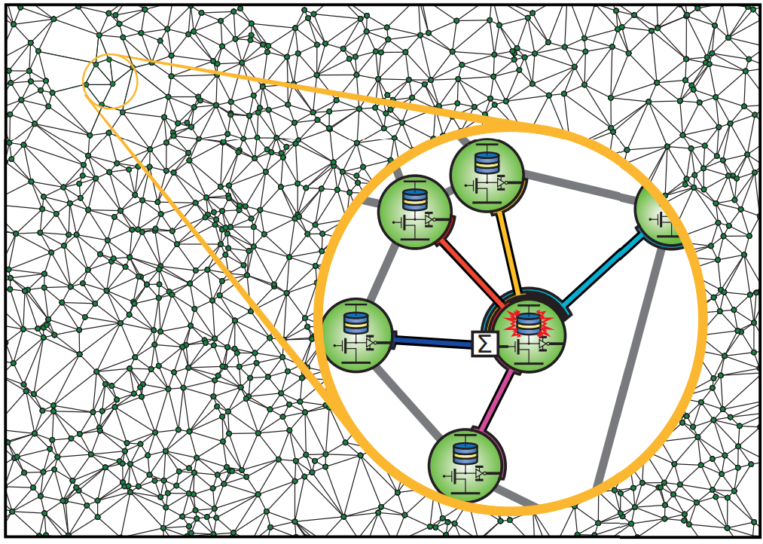
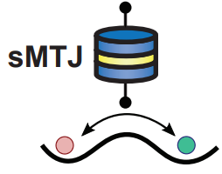
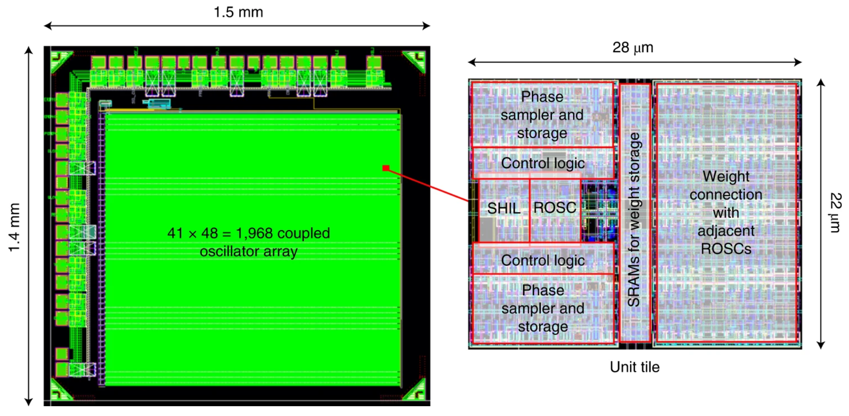
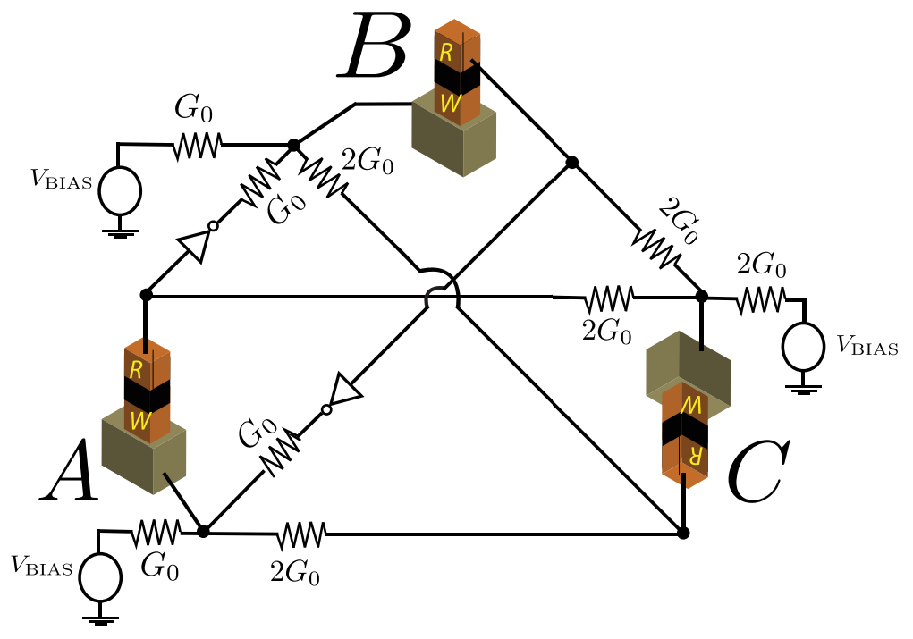
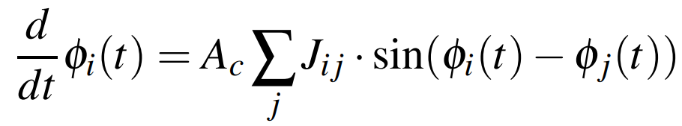
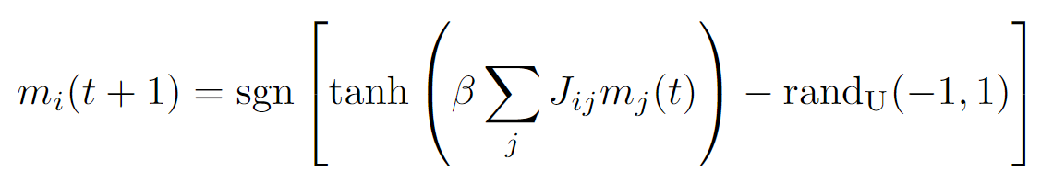
Example: Ising machines that solve optimization problems
Oscillator Ising Machines
Probabilistic-Bit (p-bit) Ising Machines
Source: Vadlamani et al. PNAS 117, 43 (2020)
Sources: K.Y. Camsari et al. Physical Review X 7, 031014 (2017)
N.A. Aadit et al. IEEE Intl. Conf. Nanotechnology (2022)
Source: W. Moy et al. Nature Electronics 5, 310 (2022)
Network of coupled oscillators with dynamics:
Network of coupled stochastic magnetic tunnel junctions with dynamics:
Programmable couplings
Other examples
T. Wang et al. arXiv:1709.08102 (2017)
S.R. Vadlamani et al. PNAS 117, 43 (2020)
M.K. Bashar et al. IEEE JESSCDC 6, 2 (2020)
B. Sutton et al. Scientific Reports 7, 44370 (2017)
K.Y. Camsari et al. Physical Review X 7, 031014 (2017)
Review (covering many more examples): N.M. Mohseni, P.L. McMahon, T. Byrnes. Nature Reviews Physics 4, 363 (2022)
See talk by Eli Yablonovitch.

Slide 17
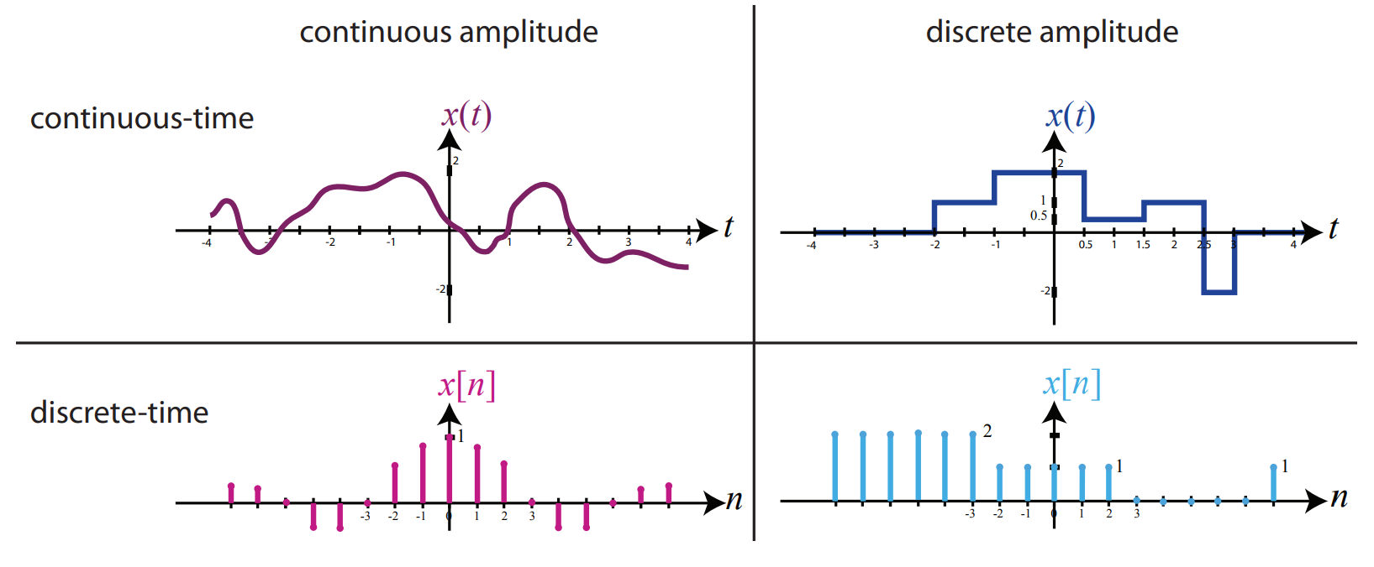
Hardware options for physics-based computers
CMOS
Electronics
Beyond-CMOS
Electronics
Superconducting
Electronics
Photonics
Mechanics
Pros
Pros
Pros
Pros
Incumbent – but need to choose between digital, analog, and mixed-signal as well as the level of abstraction to use, and these choices have pros and cons.
Low-energy (>100x improvement), small-area (>1000x improvement) random-number generation with stochastic magnetic tunnel junctions for probabilistic computing [CMF+23]
Low energy (10x improvement) with carbon-nanotube transistors [GLW+19]
Low energy (switching energy 1.4 zJ excluding cooling vs ~4000 zJ; ~1400 zJ including cooling vs ~4000 zJ [ATS21+,DCR22]) & (oscillator power ~50 nW @ ~10 GHz excluding cooling vs ~10 mW @ ~10 GHz [CKV23,PYS+22])
High bandwidth (>100 THz vs <10 GHz)
Nearly dissipationless communication and dynamics
Resistant to electromagnetic interference
Cons
Cons
Cons
Limited number of Josephson junctions per chip (size and yield)
Lack of memory
Large components (~500 nm vs ~5 nm)
Lack of memory
Slow (Hz/kHz vs GHz)
This is a very broad category with many possible other examples.
[M23]
D. Kundur. U. Toronto ECE455F (2014)
All these suffer from the disadvantage of not being CMOS: they need to overcome the massive scale, optimization, and reliability that has already been achieved in conventional CMOS if competing against CMOS at its own game (raw computation) – but the bar to win is lower for some specialized tasks (e.g., cryogenic receivers/control; optical inputs)
Where can advantage come from? (A partial list.)
Greater spatial parallelism (smaller components)
Fewer components to perform an elementary operation (e.g., 1 transistor ↔ 1 multiplication, vs >100 transistors ↔ 1 multiplication)
Higher speed and/or lower energy for a single cycle, switching event, or other operation
Reduced/eliminated synchronization (clockless, or global asynchronous-locally synchronous)
Specialized input/outputs that CMOS is not necessarily best-suited for (e.g., optical inputs)
[ATS+21] C.L. Ayala et al. IEEE JSSC 56, 4 (2021)
[CKV23] R. Cheng et al. IEEE TAS 33, 5 (2023)
[CMF+23] K. Camsari et al. arXiv:2301.06727 (2023)
[DCR22] S. Datta et al. Science 378, 6621 (2022)
[GLW+19] G. Hills et al. Nature 572, 595 (2019)
[M23] P.L. McMahon. Nature Reviews Physics 5, 717 (2023)
[PYS+22] S. Park et al. ISSCC 13.2 (2022)

Slide 18
High-level questions about Computing with Physical Systems for computer engineering
See next introduction by Arvind Murugan for big questions about fundamental science.
What architecture (the choice, layout, connectivity, etc. of physical components that make up the computer) should we use? (Probably application-/use-case-dependent, so this can be asked for each case.)
What physical system(s)/substrate(s) should we use? (CMOS electronics? Beyond-CMOS electronics? Superconducting electronics? Photonics? Mechanics?) (Probably application-/use-case-dependent, so this can be asked for each case.)
How can we harness the intrinsic computation performed by a physical system (which might or might not have been carefully architected) to make it do a useful computation? (E.g., how can we efficiently train a physical system to perform neural-network-like inference for us?)
How should we deal with copy-to-copy variations and noise?
What are the right applications to target? (Machine learning, and especially neural networks? Optimization? Scientific computing? Others?) (And within each broad application area, what more specific applications?)
What are the right use cases? (Edge vs server/cloud? Sensor processing vs stored-data processing?)
How do we bridge the gap between what we can create now and what we need to beat conventional CPUs/GPUs at the most high-value applications (e.g., neural networks)?
How and when can quantumness be useful?
What are the fundamental and practical limits to energy efficiency and speed (throughput and latency)?
… (This is obviously an incomplete and subjective list. I hope that throughout the conference other important questions will be highlighted.)

